Slide 1
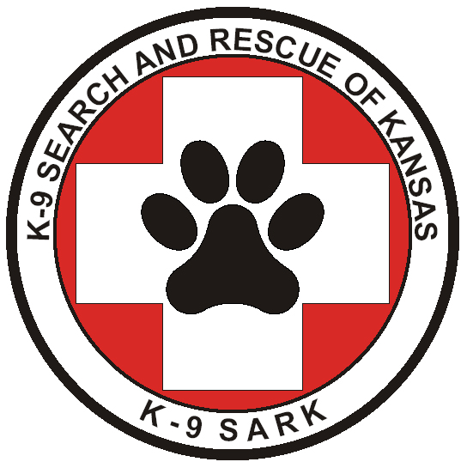

Slide 2
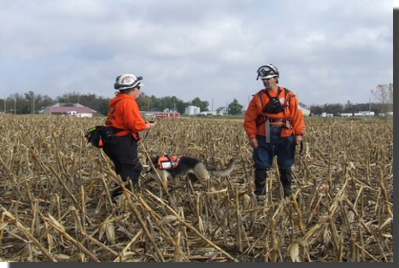
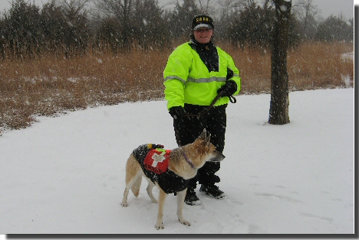
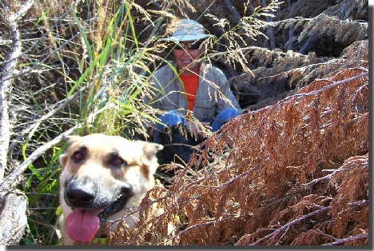
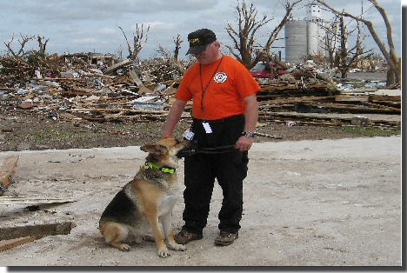
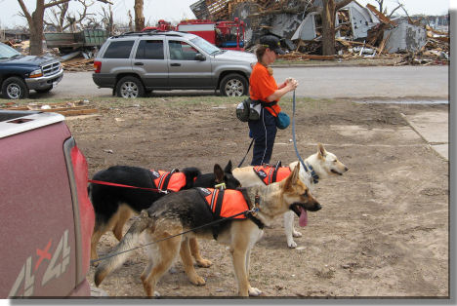

Slide 3
How does an
AIR SCENT
SEARCH & RESCUE
DOG work?
Follow the pictures and descriptions on the following slides to see one of K9SARK’s dogs in action and to learn what a nationally certified air scent search and rescue dog does.

Slide 4
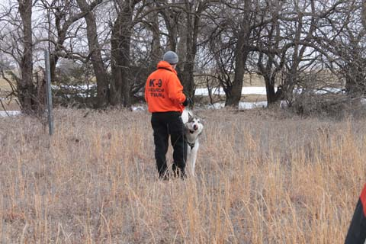
Together, Lincoln’s handler (Don) and Lincoln make up a canine search and rescue team. Neither one can do the job without the other. In this picture, Don is getting ready to release Lincoln. Notice Lincoln’s tongue is out licking his nose…that’s because he’s looking forward to the food reward he will get once he finds the missing subject ☺.

Slide 5
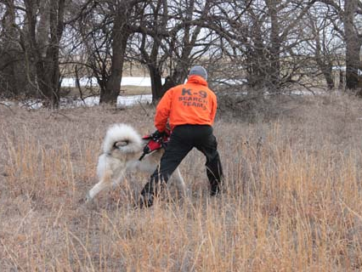
In this picture, Don is releasing Lincoln while giving him his command to search. It is important that the handler is also energized and ready to go because the dog will feed off of his energy and attitude.

Slide 6
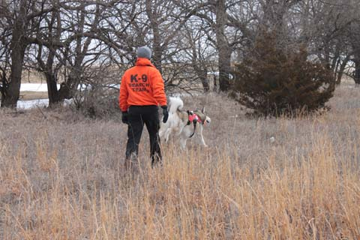
Lincoln is off! Notice the bright colored vest he is wearing. It identifies him as a search and rescue dog. When Lincoln is wearing his vest, he knows he has a job to do. There are bells attached to the vest so that the handler can hear his dog even when he may not be able to see him due to trees or tall grasses. The handler can also attach lights to the vest so that he can see his dog during night searches. A search dog may also wear protective doggie booties on his feet if the terrain requires it.

Slide 7
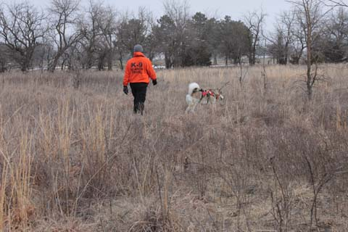
The human subject is hidden somewhere in this large field. All humans constantly slough off skin cells that carry human odor. These skin cells travel on air currents. An air scent search and rescue dog is taught to alert his handler when he smells these skin cells. The handler will help by directing the dog in a pattern that is perpendicular to the direction of the wind.

Slide 8
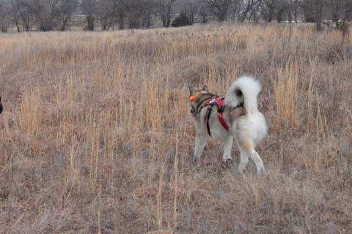
An air scent dog works with his nose up, not on the ground like a tracking or trailing dog would. He wants to keep his nose up so that he can catch the scent of the skin cells that are traveling on the breezes. The skin cells also settle on the tops of the tall grasses…because of this, a short statured dog like a dachshund would have a harder time catching the scent.

Slide 9
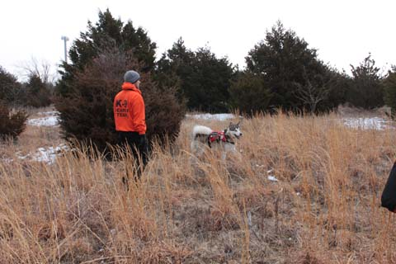
Don and Lincoln are now among some evergreen trees. Because the scent has a tendency to swirl around trees, this is more challenging for the dog than searching in a wide open field. This is also more challenging for the handler because he still has to make sure he follows a set pattern so that he can conclude with confidence that his entire area was thoroughly searched.

Slide 10
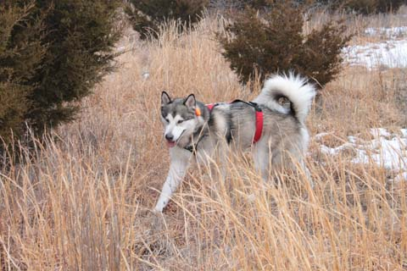
Lincoln is working among the trees. The handler encourages his dog to stick with it. However, it is very important that the handler NOT talk to his dog too much during a search. Instead, the dog is allowed to think things out for himself.

Slide 11
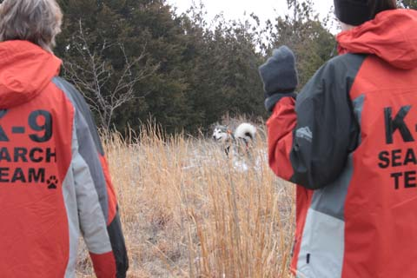
Here, Lincoln’s pace has picked up. He looks more alert and energized. Each handler has to be in tune to his dog’s body language during a search. Each dog reacts differently once it smells human scent. In the picture, Lincoln’s entire body perks up and he starts bounding towards the direction that the scent is coming from.

Slide 12
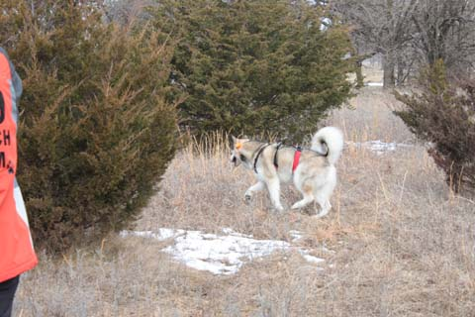
Lincoln is still trying to work things out in his brain to determine where the scent is coming from. Search dogs have to be persistent and focused. They also have to be able to work off-lead for extended periods while still following commands and signals from their handlers.

Slide 13
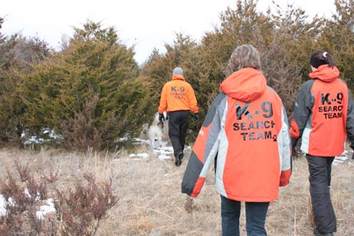
Lincoln is closing in on the subject. During this training exercise, Lincoln had over 40 acres to search. Some of the area was full of tall grasses, and some of the area was full of large evergreen trees. It took Lincoln roughly 15 minutes to search until he found the subject. When someone is lost, every passing minute can mean life or death. So, utilizing a dog’s sense of smell in order to find the lost person faster just makes good sense!

Slide 14
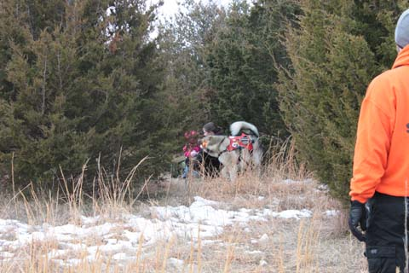
In this picture, Lincoln has found his subject….two of them in fact! Search and rescue dogs must have a good temperament and must be friendly towards strangers of all ages.

Slide 15
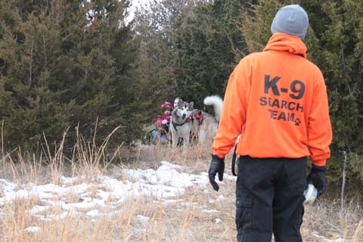
Here you can see Lincoln look back towards his handler as if to say, “Hey, Dad, look what I found!” Notice that Lincoln is alert and animated. Searching is a great game to Lincoln, and he has lots of fun taking care of his job.

Slide 16
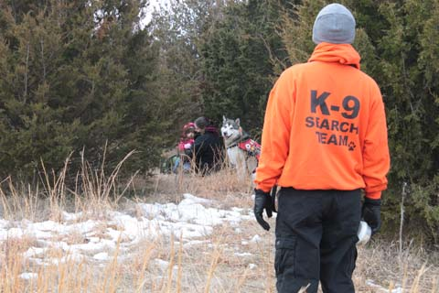
Notice that Lincoln stays next to the subjects. Lincoln’s training involves finding the subject, staying with the subject, and giving an audible sound indicating that he has found the subject.

Slide 17
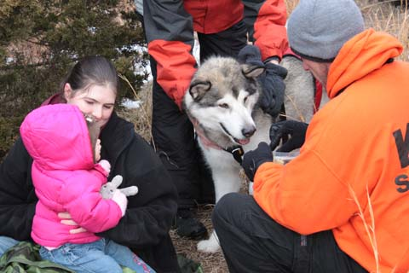
Lincoln is patiently waiting for his reward. He is totally food-motivated which means he always gets food treats once he’s found his subjects. Many search dogs are toy-motivated which means that they get to play with their favorite toy after they find their subjects.

Slide 18
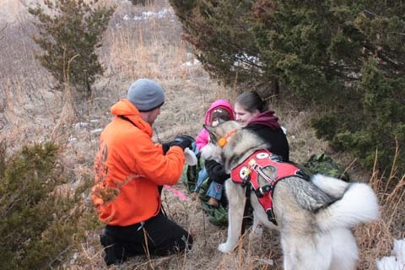
Party on! The handler celebrates finding the subject for at least one or two minutes, with Lincoln getting lots of praise and petting mixed in with the food treats. He has to have a good time searching and enjoy what he does in order to remain an effective search dog.

Slide 19
Well, there you have it. Now you know what an air scent search and rescue dog does. Remember, these dogs are trained to detect the scent of human skin cells carried by air currents…they are not looking for a specific human….just human scent in general. This makes them very useful in quickly finding missing people in a variety of situations.
K-9 Search & Rescue of Kansas does NOT self-deploy. We are always on-call to help free of charge when our services are requested.

Slide 20
For more information about K-9 Search & Rescue of Kansas, please contact:
Laurie Vickery, Director of Operations email: smokiebe@swbell.net home phone: 316-773-4026 cell phone: 316-641-2862
Justin Swank, Deputy Director of Operations email: firemanswank1983@yahoo.com home phone: 620-563-7084 cell phone: 620-629-0748
TEAM WEBSITE: k9sark.org

